Slide 1

State and nation
Dr. Hasan Muhammad Baniamin

Slide 2
Elements of state
Population
Territory
Government
Sovereignty- The highest power that gives the state freedom of action within its own territory.

Slide 3
State
Legal Definition of the State
  the state is a territorially bound sovereign entity.
  The idea of sovereignty emerged in the sixteenth and seventeenth centuries.
  In current interpretations, sovereignty is the premise that each state has complete authority and is the ultimate source of law within its own boundaries.
  Sovereignty is the key element in the legal concept of the state.

Slide 4
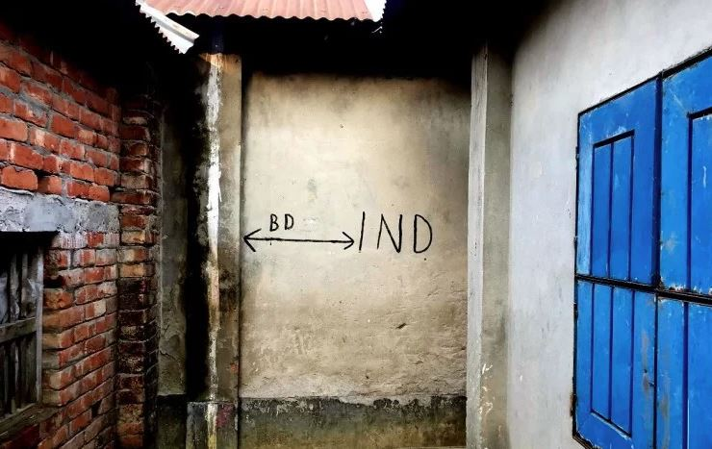
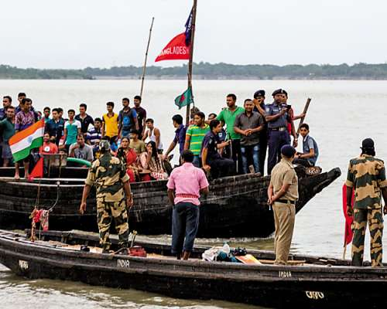

Slide 5
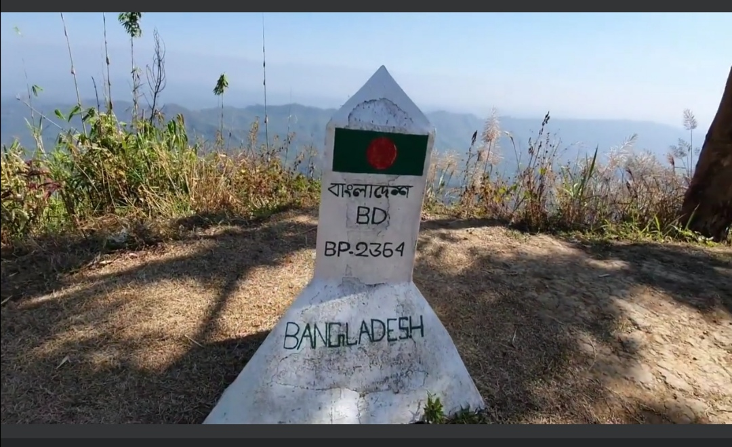
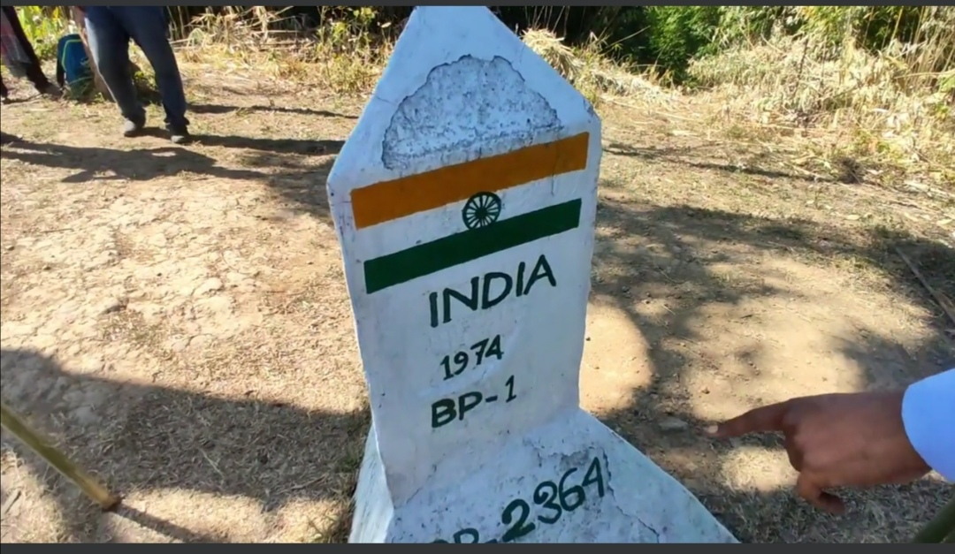
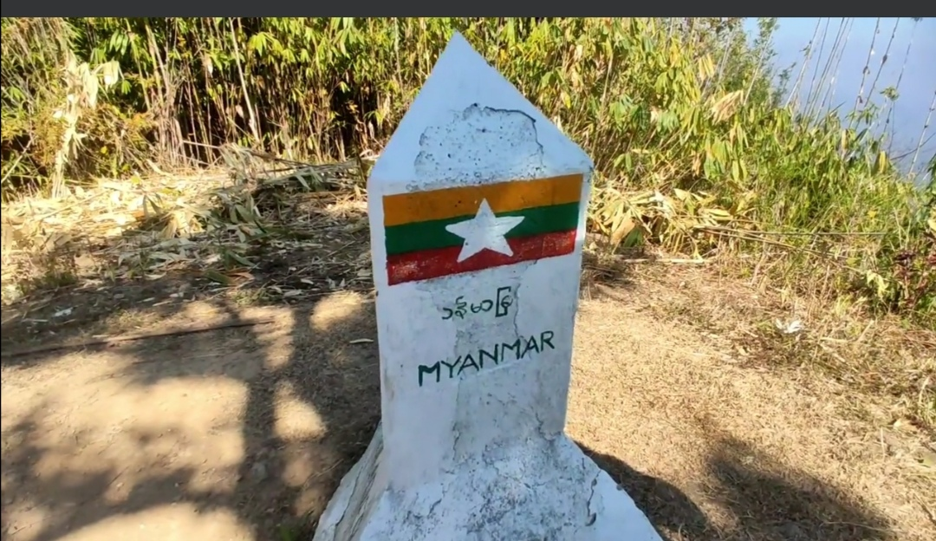

Slide 6
State
Structural–Functional Definition of the State
  The state is defined as a country’s organized institutional machinery for making and carrying out political decisions and for enforcing the laws and rules of the government.

Slide 7
Major Goals of a state
Three overarching goals:
  security,
  stability, and
  prosperity.

Slide 8
Security
1. Survival entails the very existence of the state, such that other states do not conquer it and that internal forces do not destroy it.
2. Autonomy refers to the capacity of the state to act within its own boundaries without intervention in or control of its affairs by external actors.
3. Influence involves the state’s ability to alter the actions of external actors in desired ways by means of persuasion or inducements.
4. Prestige is the desirable situation wherein external actors admire and respect the state.
5. Dominance is the use of power or violence to enable the state to impose direct control over external actors.

Slide 9
Stability
1. Order maintenance is the capacity of the state to ensure social peace for its citizens through the prevention of individual and group violation of societal norms, especially those involving violence.
2. Political development refers to the concentration of political authority in a state that has strong capabilities to make and enforce effective policies and to gain support from its citizens.
3. Democratization is the process of institutionalizing a democratic system of governance, which is achieved by allowing free elections, limiting the actions of the rulers, and guaranteeing civil and political rights.

Slide 10
Prosperity
1. Economic growth refers to the increasing scale, complexity, and specialization of the productive system and of the goods produced.
2. Welfare distribution refers to the private or public allocation of adequate and increasing levels of valued goods to enhance the quality of life of the citizenry.

Slide 11
Nation
A nation is defined as a set of people with a deeply shared fundamental identification.
Different factors might be the basis of such identification: shared descent (belief in a common kinship or history), shared culture, shared geographic space, shared religion, shared language, or shared economic order.

Slide 12
Nation–state
A nation–state, which is an area that has both the territorial borders of a single state and a citizenry who all share the same primary national identity.
Only a few modern states have the combination of common culture, history, ethnicity, religion, and language that results in a strong sense of shared nationality among nearly all the citizens governed by the state.

Slide 13

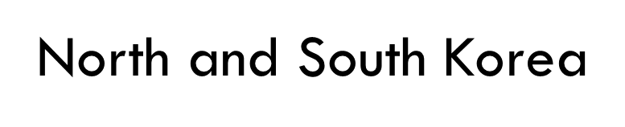
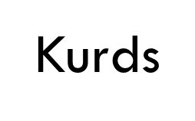
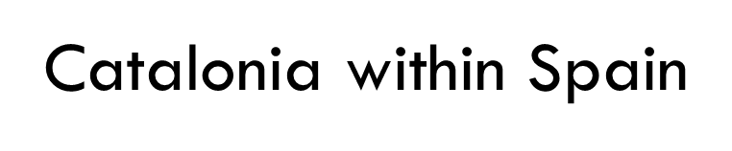
Nation–state
Nation–state
One nation is split into two states
A stateless nation
Multinational states

Slide 14
Suggested readings
Danziger, J. N., & Smith, C. A. (2016). Understanding the political world: A comparative introduction to political science. Boston :Pearson. Chapter 5, pp.111-123

Slide 15
Q?

